Slide 1
arda
Projects in review

Slide 2
Welcome to arthington

Slide 3
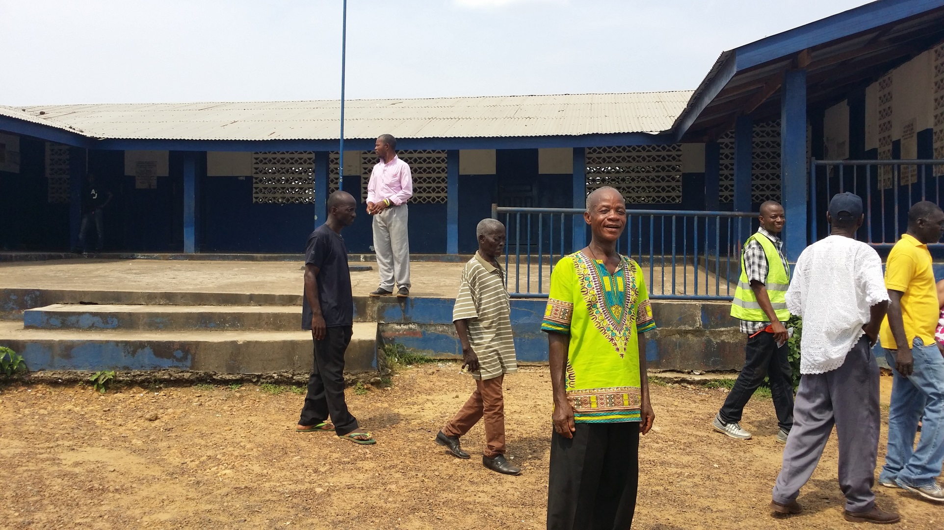
ARTHINGTON CENTRAL SCHOOL

Slide 4
THE MAIN CAMPUS

Slide 5
THE CAMPUS`

Slide 6
THE CAMPUS`

Slide 7
THE CAMPUS`

Slide 8
THE GROWING POPULATION

Slide 9
DESERVING STUDENTS

Slide 10
THE OLD KINDERGARDEN BUILDING

Slide 11
BUILDING CHOSEN FOR RENOVATION

Slide 12
THE NEW LOOK

Slide 13
ROOF REPLACED

Slide 14
THE ROOF NEEDING MORE WORK

Slide 15
INSIDE THE CLASSROOMS

Slide 16
THE CLASSROOMS

Slide 17
MORE CLASSROOM

Slide 18
MORE OF THE STUDENTS

Slide 19
Ebola supplies 2014

Slide 20
More Ebola supplies 2014

Slide 21
Encouraging prevention during the Ebola crisis

Slide 22
Washing station in one of the villages

Slide 23
The road project

Slide 24
The road project

Slide 25
The road project

Slide 26
The road project 2015

Slide 27
CREATING A READING ROOM

Slide 28
THE VISUAL

Slide 29
3D IMAGING

Slide 30
THE MAKING OF THE READING ROOM

Slide 31
THE NAME OF THE LIBRARY

Slide 32
Mrs. Partena laura graham askie

Slide 33
Cite of the library

Slide 34
BUILDING THE READING ROOM

Slide 35
Implementing

Slide 36
WALLS GOING UP

Slide 37
NEARING COMPLETION

Slide 38
Shipment of books

Slide 39
Finished product

Slide 40
The P.l.g.a. library

Slide 41
Faculty in the library

Slide 42
Backpacks and stuffed animals delivered may 2016

Slide 43
The library PTA president

Slide 44
Backpacks delivered in may 2016

Slide 45
microscopes delivered in may 2016

Slide 46
microscopes delivered in may 2016

Slide 47
Educational toys delivered in may 2016

Slide 48
Educational toys delivered in may 2016

Slide 49
Book shelf repairs needed

Slide 50
ceiling repairs needed

Slide 51
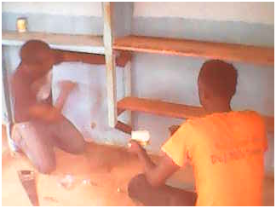
Book shelf treatment

Slide 52
Ceiling repairs

Slide 53
Ceiling repairs

Slide 54
Additional tables & chairs

Slide 55
Additional table & chairs

Slide 56
partnership

Slide 57
KEEP leadership Brenda More – Executive Director

Slide 58
Library pre-renovation 2018

Slide 59
KEEP renovation library before

Slide 60
Library renovation 2018

Slide 61
Library pre-renovation 2018

Slide 62
Library pre-renovation 2018

Slide 63
Library renovation 2018

Slide 64
Library renovation 2018

Slide 65
Library renovation 2018

Slide 66
Library renovation 2018

Slide 67
Library renovation 2018

Slide 68
Library renovation 2018

Slide 69
Library renovation 2018

Slide 70
Library renovation 2018

Slide 71
Library renovation 2018

Slide 72
Library renovation 2018

Slide 73
Library renovation 2018

Slide 74
Library renovation 2018

Slide 75
Library renovation 2018

Slide 76
Library renovation 2018

Slide 77
Library renovation 2018

Slide 78
Library renovation 2018

Slide 79
Library renovation 2018

Slide 80
Library renovation before & after 2018

Slide 81
Library what next? Right kind of books

Slide 82
Library what next? Teacher training

Slide 83
Library what next? Reading assessment

Slide 84
2018 shipment 15” lenovo laptop computer

Slide 85
2018 shipment 15” lenovo laptop computer/principal

Slide 86
2018 shipment hp office jet printer

Slide 87
2018 shipment notebooks

Slide 88
2018 shipment notebooks

Slide 89
2018 shipment pencils

Slide 90
2018 shipment pens

Slide 91
2018 shipment washable markers

Slide 92
2018 shipment pencil sharpeners

Slide 93
2018 shipment puzzles

Slide 94
2018 shipment encyclopedias

Slide 95
2018 shipment children table & chair

Slide 96
2018 shipment children chairs

Slide 97
2018 shipment encyclopedias

Slide 98
2018 shipment encyclopedias

Slide 99
The arthington community clinic

Slide 100
2018 Christmas Party

Slide 101
2018 Christmas Party

Slide 102
2018 Christmas Party

Slide 103
The main entrance to the clinic

Slide 104
Inside the clinic

Slide 105
Ebola center

Slide 106
The waiting room

Slide 107
Patients in the waiting room

Slide 108
Arthington’s mayor

Slide 109
Doctor’s office

Slide 110
The recovery room

Slide 111
Clinical beds

Slide 112
Inside the clinic

Slide 113
Drug store

Slide 114
The drug store

Slide 115
More drugs

Slide 116
Doctors’ quarter

Slide 117
What arthington look like

Slide 118
ST. PAUL BAPTIST CHURCH

Slide 119
ST. PAUL BAPTIST CHURCH

Slide 120
MOUNT CARMEL AME CHURCH

Slide 121
ST. PAUL BEING REBUILT

Slide 122
destroyed RESIDENCE

Slide 123
Destroyed RESIDENCE

Slide 124
Destroyed RESIDENCE

Slide 125
Destroyed CITY HALL

Slide 126
BANANA ORCHIRD

Slide 127
LOCAL RESIDENTS

Slide 128
REBUILDING the city hall

Slide 129
ARTHINGTON’S POLICE STATION

Slide 130
THE POLICE STATION

Slide 131
ARTHINGTON MAGISTRIAL COURT

Slide 132
INSIDE THE COURTROOM

Slide 133
REBUILDING

Slide 134
RENOVATION ON THE WAY

Slide 135
BEAUTY RESIDENCE

Slide 136
MORE RESIDENCE

Slide 137
PARTIAL VIEW OF THE HYDRO

Slide 138
St paul RIVER

Slide 139
CONSTRUCTION OF THE HYDRO

Slide 140
THANK YOU!!

